Slide 1
Human Motion Recognition
Using IMU Sensors
Aslı Beyza Ceyhan | Muhammed Kılıçaslan | Berke Tüylek
Istanbul Technical University
Electronic & Communications / Control & Automation Engineering
January 2026

Slide 2
Introduction & Objectives
Project Overview
  Development of a Human Activity Recognition (HAR) system using IMU sensors.
  Utilizes a CNN-based machine learning model to classify motion.
Key Objectives
  Precision: High accuracy classification of daily activities.
  Scalability: Designed for real-time, gesture-controlled applications.
  Tools: Implemented using MATLAB and Simulink.
Why IMU Sensors?
  Low power consumption and compact size.
  Privacy-friendly (no cameras required).
  High sampling rates ideal for dynamic motion.

Slide 3
Data Acquisition & Pipeline
Dataset Structure
  Sensors: Two 3-axis Accelerometers (Lower-back & Thigh).
  Input Features: 6 channels (back_x, back_y, back_z, thigh_x, thigh_y, thigh_z).
  Handling: MATLAB 'datastores' used for out-of-memory processing.
Preprocessing Steps
  Segmentation: Sliding window of 500 samples with 50% overlap (250 samples).
  Filtering: Removal of 'Ignored Labels' (classes with insufficient data).
  Normalization: Z-score applied per window (X_norm = (X-μ)/σ).
  Benefit: Removes amplitude variations and sensor placement bias.

Slide 4
Deep Learning Solution Strategy
1D Convolutional Neural Network (CNN)
  Designed specifically for sequential time-series data.
Layer Hierarchy
  Feature Extraction (Conv1D): Filter depth increases 32 → 64 → 128.
  Batch Normalization: Ensures training stability.
  Max Pooling: Reduces noise and dimensionality.
  Dropout & Global Average Pooling: Prevents overfitting and improves generalization.
  Classification: Softmax layer outputs probability distribution.

Slide 5
Training Configuration
Optimization Settings
  Optimizer: Adam (Adaptive Moment Estimation).
  Schedule: Learning rate decay applied every 25 epochs.
  Duration: 75 Epochs.
  Batch Size: 16.
Performance Monitoring
  Primary Metric: F-Score (chosen to handle class imbalance).
  Hardware: GPU acceleration enabled for computational efficiency.

Slide 6
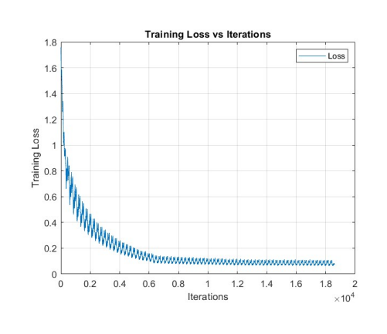
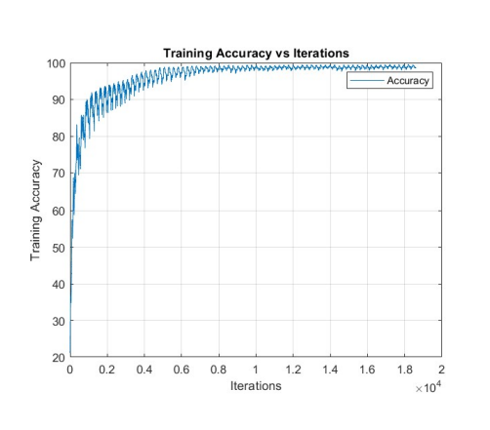
Training Convergence
Observation: Loss stabilizes below 0.2 while accuracy converges above 95%.

Slide 7
Quantitative Results
Activity | Accuracy (%) | Precision | Recall | F1-Score
Standing | 93.75 | 0.78 | 1.00 | 0.88
Walking | 94.74 | 1.00 | 0.82 | 0.90
Sitting | 98.38 | 0.99 | 0.94 | 0.96
Lying | 100.00 | 1.00 | 1.00 | 1.00
Running | 97.21 | 0.81 | 0.85 | 0.83
AVERAGE | 96.74 | 0.92 | 0.92 | 0.92

Slide 8
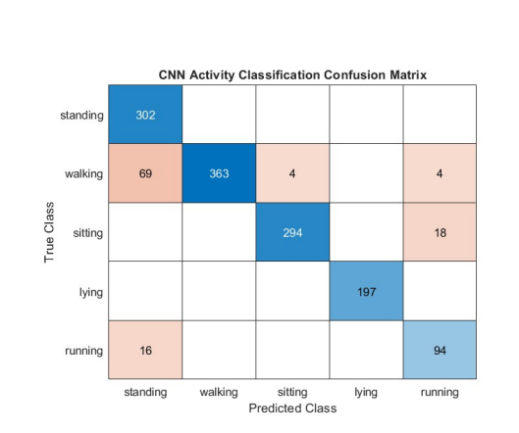
Error Analysis (Confusion Matrix)
Key Insights:
• High Distinction: 'Lying' and 'Sitting' are classified with near perfection.
• Minor Confusion: Some overlap exists between 'Standing' and 'Walking' due to signal similarity.
• Overall: The model demonstrates robust generalization across activity classes.

Slide 9
Conclusion & Future Work
Conclusion
  Successfully implemented a scalable 1D CNN for IMU-based activity recognition.
  Achieved an average accuracy of 96.74%, validating the chosen architecture.
  Preprocessing pipeline (Z-score, Windowing) effectively handled sensor variability.
Future Work
  Integration into real-time applications via MATLAB imuSensor.
  Testing on diverse body types to improve generalization.
  Expansion to gesture-controlled hardware interfaces.

